Slide 1
SSZG 518: Database Design and Applications
Today’s Class
Transaction Management

Slide 2
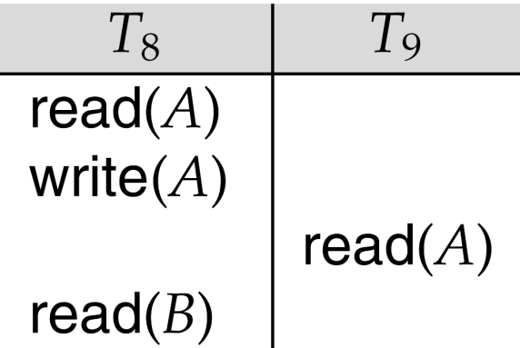
Recoverable Schedules
Need to address the effect of transaction failures on concurrently running transactions.
Recoverable schedule — if a transaction T_{j} reads a data item previously written by a transaction T_{i} , then the commit operation of T_{i} appears before the commit operation of T_{j}.
The following schedule (Schedule 11) is not recoverable if T₉ commits immediately after the read
If T₈ should abort, T₉ would have read (and possibly shown to the user) an inconsistent database state. Hence, database must ensure that schedules are recoverable.

Slide 3
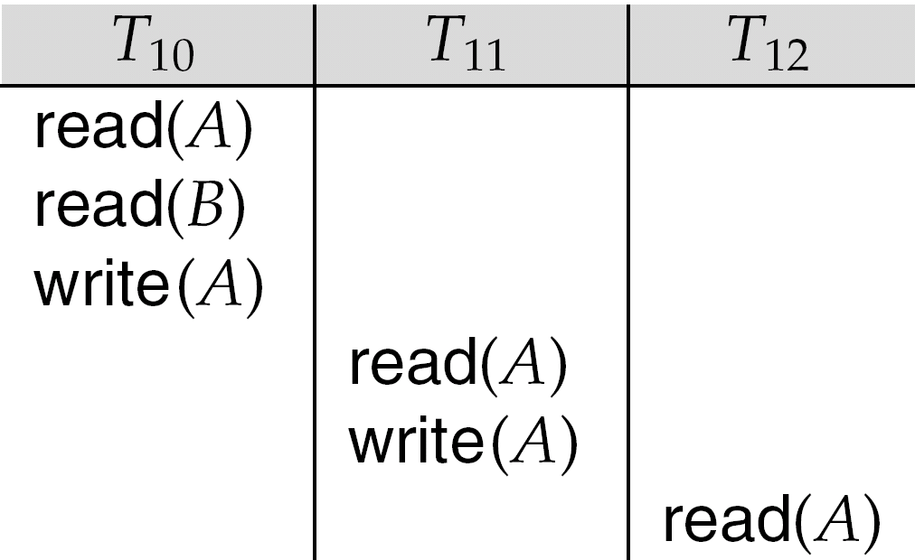
Cascading Rollbacks
Cascading rollback – a single transaction failure leads to a series of transaction rollbacks. Consider the following schedule where none of the transactions has yet committed (so the schedule is recoverable) If T₁₀ fails, T₁₁ and T₁₂ must also be rolled back.
Can lead to the undoing of a significant amount of work

Slide 4
Cascadeless Schedules
Cascadeless schedules — cascading rollbacks cannot occur; for each pair of transactions T_{i} and T_{j} such that T_{j} reads a data item previously written by T_{i}, the commit operation of T_{i} appears before the read operation of T_{j}.
Every cascadeless schedule is also recoverable
It is desirable to restrict the schedules to those that are cascadeless

Slide 5
Methods for Serialisability
Multi-version Concurrency Control techniques keep the old values of a data item when that item is updated.
Timestamps are unique identifiers for each transaction and are generated by the system. Transactions can then be ordered according to their timestamps to ensure serialisability.
Protocols that, if followed by every transaction, will ensure serialisability of all schedules in which the transactions participate. They may use locking techniques of data items to prevent multiple transactions from accessing items concurrently.
Pessimistic Concurrency Control
Check before a database operation is executed by locking data items before they are read and written or checking timestamps

Slide 6
Locking Techniques for Concurrency Control
The concept of locking data items is one of the main techniques used for controlling the concurrent execution of transactions.
A lock is a variable associated with a data item in the database. Generally there is a lock for each data item in the database.
A lock describes the status of the data item with respect to possible operations that can be applied to that item. It is used for synchronising the access by concurrent transactions to the database items.
A transaction locks an object before using it
When an object is locked by another transaction, the requesting transaction must wait

Slide 7
Types of Locks
Binary locks have two possible states:
1. locked (lock_item(X) operation) and
2. unlocked (unlock_item(X) operation
Multiple-mode locks allow concurrent access to the same item by several transactions. Three possible states:
1. read locked or shared locked (other transactions are allowed to read the item)
2. write locked or exclusive locked (a single transaction exclusively holds the lock on the item) and
3. unlocked.
Locks are held in a lock table.
upgrade lock: read lock to write lock
downgrade lock: write lock to read lock

Slide 8
Lock-Based Protocols
A lock is a mechanism to control concurrent access to a data item
Data items can be locked in two modes :
1. exclusive (X) mode. Data item can be both read as well as
written. X-lock is requested using lock-X instruction.
2. shared (S) mode. Data item can only be read. S-lock is
requested using lock-S instruction.
Lock requests are made to concurrency-control manager. Transaction can proceed only after request is granted.

Slide 9
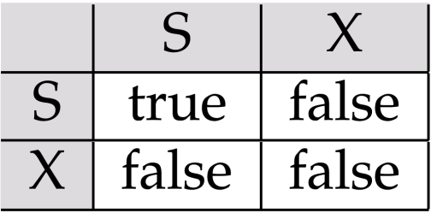
Lock-Based Protocols
Lock-compatibility matrix
A transaction may be granted a lock on an item if the requested lock is compatible with locks already held on the item by other transactions
Any number of transactions can hold shared locks on an item,
but if any transaction holds an exclusive on the item no other transaction may hold any lock on the item.

Slide 10
Lock-Based Protocols
If a lock cannot be granted, the requesting transaction is made to wait till all incompatible locks held by other transactions have been released. The lock is then granted.

Slide 11
Locks don’t guarantee serialisability
X is unlocked too early
Y is unlocked too early
Schedule 1: T1 followed by T2 ⇒ X=50, Y=80
Schedule 2: T2 followed by T1 ⇒ X=70, Y=50

Slide 12
Non-serialisable schedule S that uses locks
X=20Y=30
result of S ⇒ X=50, Y=50

Slide 13
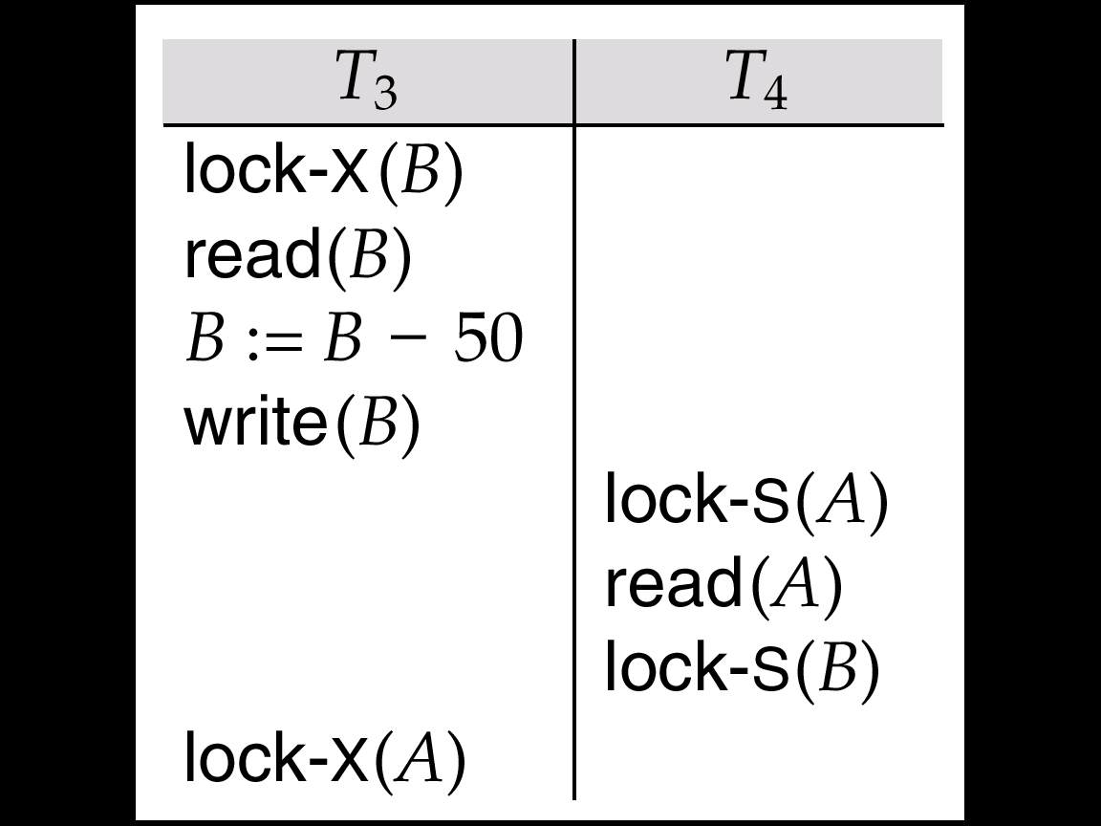
Pitfalls of Lock-Based Protocols
Consider the partial schedule
Neither T₃ nor T₄ can make progress — executing lock-S(B) causes T₄ to wait for T₃ to release its lock on B, while executing lock-X(A) causes T₃ to wait for T₄ to release its lock on A.
Such a situation is called a deadlock.
To handle a deadlock one of T₃ or T₄ must be rolled back and its locks released.

Slide 14
Pitfalls of Lock-Based Protocols
The potential for deadlock exists in most locking protocols. Deadlocks are a necessary evil.
Starvation is also possible if concurrency control manager is badly designed. For example:
A transaction may be waiting for an X-lock on an item, while a sequence of other transactions request and are granted an S-lock on the same item.
The same transaction is repeatedly rolled back due to deadlocks.
Concurrency control manager can be designed to prevent starvation.

Slide 15
The Two-Phase Locking Protocol
This is a protocol which ensures conflict-serializable schedules.
Phase 1: Growing Phase
transaction may obtain locks
transaction may not release locks
Phase 2: Shrinking Phase
transaction may release locks
transaction may not obtain locks
The protocol assures serializability. It can be proved that the transactions can be serialized in the order of their lock points (i.e. the point where a transaction acquired its final lock).

Slide 16
2PL
Two-phase locking does not ensure freedom from deadlocks
Cascading roll-back is possible under two-phase locking. To avoid this, follow a modified protocol called strict two-phase locking. Here a transaction must hold all its exclusive locks till it commits/aborts.
Rigorous two-phase locking is even stricter: here all locks are held till commit/abort. In this protocol transactions can be serialized in the order in which they commit.

Slide 17
2PL
There can be conflict serializable schedules that cannot be obtained if two-phase locking is used.
However, in the absence of extra information (e.g., ordering of access to data), two-phase locking is needed for conflict serializability in the following sense:
Given a transaction T_{i} that does not follow two-phase locking, we can find a transaction T_{j} that uses two-phase locking, and a schedule for T_{i} and T_{j} that is not conflict serializable.

Slide 18
Ensuring Serialisability: Two-Phase Locking
All locking operations (read_lock, write_lock) precede the first unlock operation in the transactions.
Two phases:
expanding phase: new locks on items can be acquired but none can be released
shrinking phase: existing locks can be released but no new ones can be acquired

Slide 19
Two-Phasing Locking
Basic 2PL
When a transaction releases a lock, it may not request another lock
Conservative 2PL or static 2PL
a transaction locks all the items it accesses before the transaction begins execution
pre-declaring read and write sets
lock point
obtain lock
number of locks
release lock
Phase 1
Phase 2
BEGIN
END

Slide 20
Two-Phasing Locking
Strict 2PL a transaction does not release any of its exclusive locks until after it commits or aborts
leads to a strict schedule for recovery
obtain lock
number of locks
release lock
Transaction duration
BEGIN
period of data item use
END

Slide 21
Example 1
T₁: {R₁(x), x = x+1, W₁(x), C₁}
T₂: {R₂(x), x = x+1, W₂(x), C₂}
Conflicting operations between T₁ and T₂:
{ (R₁(x), W₂(x)) , (R₂(x), W₁(x)) , (W₂(x),W₁(x)) }
Complete Schedule
We need to order these conflicting operations, e.g.,
R₁(x) → W₂(x)
R₂(x) → W₁(x)
W₂(x) → W₁(x)
T₁
R₁(X)
W₁(X)
C₁
T₂
R₂(X)
W₂(X)
C₂
Notes:
2
2

Slide 22
Another Way of Representing Schedules
T₁
R₁(X)
W₁(X)
C₁
T₂
R₂(X)
W₂(X)
C₂
Note the explicit ordering of R₁(X) and R₂(X)
Notes:
2
2

Slide 23
Example 2
T₁ = R₁(x) → W₁(x) → C₁
T₂ = R₂(x) → W₂(y) → W₂(x) → C₂
T₃ = R₃(y) → W₃(x) → W₃(y) → W₃(z) → C₃
T₂
R₂(x) → W₂(y) → W₂(x) → C₂
T₃
R₃(y) → W₃(x) → W₃(y) → W₃(z) → C₃
T₁
R₁(x) → W₁(x) → C₁
Notes:
2
2

Slide 24
Example 2 in Table Form
T₂
R₂(x) → W₂(y) → W₂(x) → C₂
T₃
R₃(y) → W₃(x) → W₃(y) → W₃(z) → C₃
T₁
R₁(x) → W₁(x) → C₁
Notes:
2
2

Slide 25
Precedence Graph
A set of transactions may have many possible schedules, which ones are correct?
Answer: use precedence graph
Precedence graph is a directed graph:
nodes/vertices as transactions
edges denoting precedence relationship between conflicting operations of different transactions.
For a pair of conflicting operations O_{ij} ∈ T_{i} and O_{kl} ∈ T_{k},
if O_{ij} → O_{kl} then have an edge from T_{i} to T_{k}, else
if O_{kl} → O_{ij} then have an edge from T_{k} to T_{i}
If there are more than one edge between two nodes, retain only one of the edges
Notes:
2
2

Slide 26
Precedence Graph of Example 1
T₁
R₁(X)
W₁(X)
C₁
Since there are two transactions,
we have two nodes T₁ and T₂
T₂
R₂(X)
W₂(X)
C₂
R₁(X) → W₂(X) ⇒ edge T₁ → T₂;
R₂(X) → W₁(X) ⇒ edge T₂ → T₁,
T1
T2
W₂(X) → W₁(X) ⇒ edge T₂ → T₁
A cycle in Precedence Graph implies potential for database inconsistency
Notes:
2
2
Connect to tutorial oriented presentation, and emphasize our approach

Slide 27
Precedence Graph of Example 2
T₁ = R₁(x) → W₁(x) → C₁
T₂ = R₂(x) → W₂(y) → W₂(x) → C₂
T₃ = R₃(y) → W₃(x) → W₃(y) → W₃(z) → C₃
T₂
R₂(x) → W₂(y) → W₂(x) → C₂
T1
T3
T2
T₃
R₃(y) → W₃(x) → W₃(y) → W₃(z) → C₃
T1 → T3 because W₁(x) → W₃(x);
T3 → T2 because W₃(x) → R₂(x);
T1 → T2 because W₁(x) → W₂(x)
No cycle in precedence graph so no database inconsistency.
T₁
R₁(x) → W₁(x) → C₁
Notes:
2
2

Slide 28
Using Another Schedule for Example 2
T₁ = R₁(x) → W₁(x) → C₁
T₂ = R₂(x) → W₂(y) → W₂(x) → C₂
T₃ = R₃(y) → W₃(x) → W₃(y) → W₃(z) → C₃
R₂(x) → W₂(y) → W₂(x) → C₂
T₁ → T₃ → T₂
R₃(y) → W₃(x) → W₃(y) → W₃(z) → C₃
R₁(x) → W₁(x) → C₁
PG has a cycle; the database may not be consistent
Notes:
2
2

Slide 29
Another Example on Serializability
T1
T2
T3
Schedule is NOT serializable
Notes:
2
2

Slide 30
Run-time Construction of Precedence Graph
T₁ = R₁(x) → W₁(x) → C₁
T₂ = R₂(x) → W₂(y) → W₂(x) → C₂
T₃ = R₃(y) → W₃(x) → W₃(y) → W₃(z) → C₃
R₂(x) → W₂(y)
Schedule = R₃(y) → W₃(x) → W₃(y)
R₁(x) → W₁(x) → C₁
The scheduler keeps building the Precedence Graph as the operations of active transactions are scheduled so that the PG is acyclic.
The scheduler delays scheduling those operation that can cause a cycle in PG
Notes:
2
2

Slide 31
Lock Conversions
Two-phase locking with lock conversions:
– First Phase:
can acquire a lock-S on item
can acquire a lock-X on item
can convert a lock-S to a lock-X (upgrade)
– Second Phase:
can release a lock-S
can release a lock-X
can convert a lock-X to a lock-S (downgrade)
This protocol assures serializability. But still relies on the programmer to insert the various locking instructions.

Slide 32
Automatic Acquisition of Locks
A transaction T_{i} issues the standard read/write instruction, without explicit locking calls.
The operation read(D) is processed as:
if T_{i} has a lock on D
then
read(D)
else begin
if necessary wait until no other
transaction has a lock-X on D
grant T_{i} a lock-S on D;
read(D)
end

Slide 33
Automatic Acquisition of Locks
write(D) is processed as:
if T_{i} has a lock-X on D
then
write(D)
else begin
if necessary wait until no other trans. has any lock on D,
if T_{i} has a lock-S on D
then
upgrade lock on D to lock-X
else
grant T_{i} a lock-X on D
write(D)
end;
All locks are released after commit or abort

Slide 34
Implementation of Locking
A lock manager can be implemented as a separate process to which transactions send lock and unlock requests
The lock manager replies to a lock request by sending a lock grant messages (or a message asking the transaction to roll back, in case of a deadlock)
The requesting transaction waits until its request is answered
The lock manager maintains a data-structure called a lock table to record granted locks and pending requests
The lock table is usually implemented as an in-memory hash table indexed on the name of the data item being locked

Slide 35
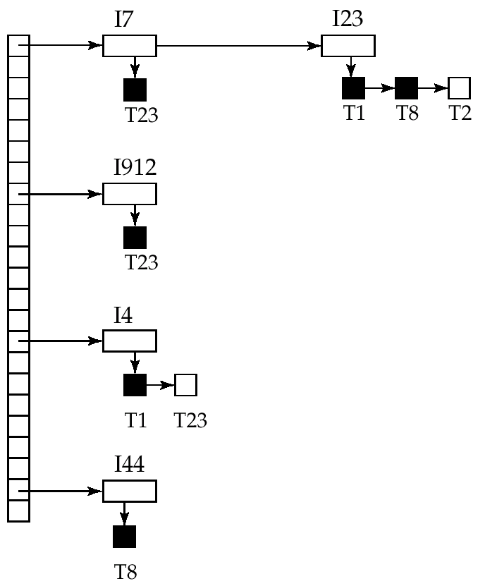
Lock Table
Black rectangles indicate granted locks, white ones indicate waiting requests
Lock table also records the type of lock granted or requested
New request is added to the end of the queue of requests for the data item, and granted if it is compatible with all earlier locks
Unlock requests result in the request being deleted, and later requests are checked to see if they can now be granted
If transaction aborts, all waiting or granted requests of the transaction are deleted
lock manager may keep a list of locks held by each transaction, to implement this efficiently

Slide 36
Graph-Based Protocols
Graph-based protocols are an alternative to two-phase locking
Impose a partial ordering → on the set D = {d₁, d₂ ,..., d_{h}} of all data items.
If d_{i} → d_{j} then any transaction accessing both d_{i} and d_{j} must access d_{i} before accessing d_{j}.
Implies that the set D may now be viewed as a directed acyclic graph, called a database graph.
The tree-protocol is a simple kind of graph protocol.

Slide 37
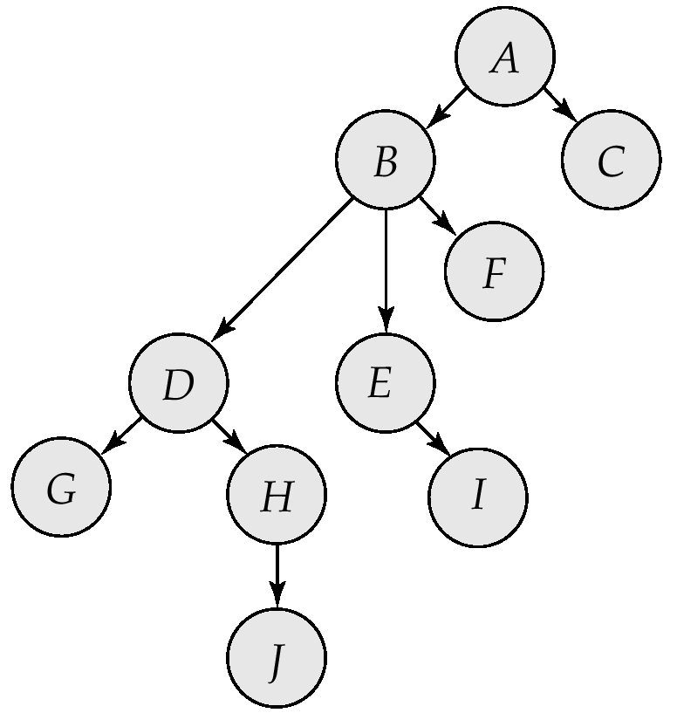
Tree Protocol
Only exclusive locks are allowed.
The first lock by T_{i} may be on any data item. Subsequently, a data Q can be locked by T_{i} only if the parent of Q is currently locked by T_{i}.
Data items may be unlocked at any time.
A data item that has been locked and unlocked by T_{i} cannot be subsequently be relocked by T_{i}

Slide 38
Graph-Based Protocols
The tree protocol ensures conflict serializability as well as freedom from deadlock.
Unlocking may occur earlier in the tree-locking protocol than in the two-phase locking protocol.
shorter waiting times, and increase in concurrency
protocol is deadlock-free, no rollbacks are required
Drawbacks
Protocol does not guarantee recoverability or cascade freedom
Need to introduce commit dependencies to ensure recoverability
Transactions may have to lock data items that they do not access.
increased locking overhead, and additional waiting time
potential decrease in concurrency
Schedules not possible under two-phase locking are possible under tree protocol, and vice versa.

